Slide 1

JC CONSULTING
Team Members:
Tam Dang
Christopher Santin
Quan Trinh

Slide 2
Project Description
⚡︎ Allows individual companies and potential talented employees to contact each other through a central, experienced company (JC Consulting) that will handle all vetting and matching to requirements by both parties
⚡︎ Saves time and effort on both sides and prevent contractor/company matches that leave either side dissatisfied.
⚡︎ Works with BA and other CPA team.

Slide 3
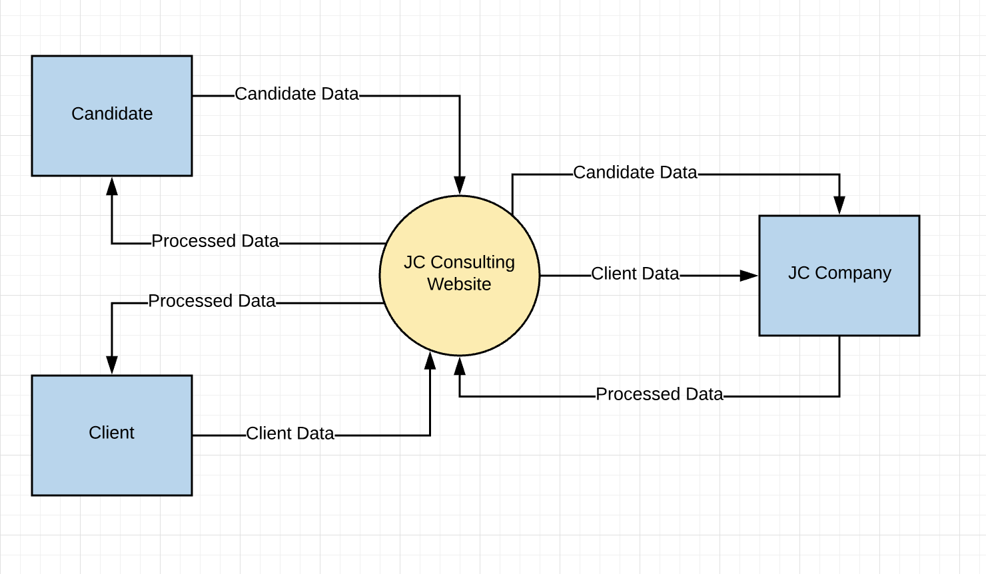
High Level Requirement

Slide 4
Scope
In Scope:
- Responsive and friendly GUI
- Login/logout and AUTH mechanisms
- Auto-generated documents for both employers and employees
- Current system analyzation and assessment
- Website support and Database maintenance
Out Scope:
- Cross-platform
- Cloud database
- Associated social networks
- Google indexing

Slide 5
Stakeholder and User Descriptions
Stakeholder summary
Stakeholder Name | Represents | Role
JC Consulting | These executives represent the owners and establishers of JC Consulting. | Setting requirements and needs for the project.
Professor Tyler Krimmel | George Brown Contact Point | Liaison between JC Consulting and George Brown CPA and BA students.
Clients (Companies) | Companies looking for employees | Using the system to find and match with contractors.
Contractors | Individuals looking for work | Using the system to find and match with companies.

Slide 6
Stakeholder and User Descriptions
User Summary
User Name | Description | Responsibilities | Stakeholder
Administrators | Employees for JC Consulting responsible for the website/database. | Maintain system efficiency and solve any issues that might arise in the database. Keep database information up to date. Link clients with contractors. | JC Consulting
Clients | Companies looking to JC Consulting to find employees. | Enter job offers. Choose contractors from those connected from Administrators (or reject choices). | Clients
Contractors | Individuals looking to JC Consulting to help them find work. | Enter resumes and keep up to date. Inform of interest in particular job offers. Accept or reject connected opportunities. | Contractors

Slide 7
Stakeholder and User Descriptions
User Requirements
Contractor | Company | Administrator
Register, Login, Logout |  | Update user profiles
Profile creation and control |  | Update and access database
Resume creation/updating | Position creation | Match contractors to company positions
View positions | View/select candidates | Report results to users
View offer notifications | Contact candidates

Slide 8
Stakeholder and User Descriptions
User Expectations
Companies | Contractors | Administrators
- Simple, streamlined interface - Fluid options for applicant selection - Matching jobs with suitable applicants | - Complex, detailed interface - Apply to jobs both automatically and by choice | - Modify candidate availabilities - Match candidates with companies for specific jobs

Slide 9
Additional Features
⚡︎ Candidate analysis and ranking
⚡︎ Candidate/Position tagging and filtering
⚡︎ Form automation
⚡︎ Background listing options
⚡︎ Basic machine intelligence
⚡︎ Multi platform support (optional)

Slide 10
Project Plan
⚡︎ Objectives
Website and app that targets user’s tag matching, profile and resume analyzing to find lists of potential candidates for various positions
⚡︎Cooperate goals addressed
Ability to both store and update candidate and company profiles in a way that allows for the easy matching of hopeful employees and the businesses that are looking to hire them.

Slide 11
Project Plan
Constraints
⚡︎ JC Consulting requirements and needs
⚡︎ Grasp the sense of the whole project and fully understand the concept, models and terms which are created and defined by BA team
⚡︎ Framework or opensource will be used and how to implement them
⚡︎ Each other’s availability and unanimous schedule
⚡︎ Constraints in knowledge of algorithms and complex mechanism
⚡︎ Adapt to agile approach and how to build the system from scratch
⚡︎ Deciding on who will be assigned what tasks and define the deadline for each of these tasks

Slide 12
Project Plan
Assumptions
⚡︎ The team might be advised and requested to change if there are any feature or operation that doesn’t meet the need or defined requirements
⚡︎ The team will be focusing on the candidate part of the database work and related applications, as another team will be handling the client side.
⚡︎ The project might change as any updates in the technologies, new information or issues are revealed
⚡︎ Project flow will be ensured by project manager and coordinator
⚡︎ Project teams will meet regularly and ensure all tasks are on track

Slide 13
Project Plan
Deliverables
Deliverable | Description
JC Consulting Website | Website & interface for JC Consulting users (both candidates and clients) so they can access services.
Candidate Database | Database of candidates, their resumes/skills, current availability
Client Database | Database of clients, current positions they are looking to fill
Candidate Applications | Add and update resumes, job applications, and skill settings.
Client Applications | Create and manage job postings and requirements
Matching application | Narrow down potential candidates for a job position based on requirements.

Slide 14
Project Plan
⚡︎ Meetings
Meeting | Purpose | Attendees | Frequency
Scrum Meetings | Establish current state of work and next tasks | Team members | Weekly or Biweekly, as necessary.
Project Meetings | Coordinate tasks and documentation between two CPA groups and BA team | Team members, Client CPA team, BA team | Biweekly, as necessary.

Slide 15
Project Plan
⚡︎ Task Listing (WBS- Work Breakdown Structure)
Reference | Tasks | Duration |  | Dependency
A | JC Consulting Website |  | Two weeks
B | Candidate Database | Two weeks
C | Candidate Applications | Three weeks |  | A, B
D | Matching Application | Three weeks |  | A, B, C
E | Testing | Eight weeks |  | A, B, C, D

Slide 16
Project Plan
⚡︎ Gantt Chart
Task | Weeks |  |  |  |  |  |  |  |  |  | Complete
 | 1 | 2 | 3 | 4 | 5 | 6 | 7 | 8 | 9 | 10
A | X | X |  |  |  |  |  |  |  |  | Week 2
B |  | X | X |  |  |  |  |  |  |  | Week 3
C |  |  |  | X | X | X |  |  |  |  | Week 7
D |  |  |  |  |  |  | X | X | X |  | Week 9
E |  |  | X | X | X | X | X | X | X | X | Week 10

Slide 17
Project Plan
⚡︎ Milestones
Major Activity or Milestone | Estimated Milestone Target date | Owner/Reviewer Team Members
Website set up and ready for added applications. | Week 2
Database built and functional. | Week 3
Candidate applications built. | Week 6
Matching application finished and matched to Client applications and database. | Week 9
Testing finished, product ready. | Week 10

Slide 18
Risk Assessment
Risk | Severity | Likelihood
Multiple teams working on the same project | M | H
Corporate changes to project design | M | H
Individual and group team availability | M | H
Condradictory design between teams | H | L

Slide 19
Product Backlog
ID | Story | Estimation | Priority
1 | As a candidate/client user, I want to register for an account | 1 | 1
2 | As a candidate/client user, I want to login the system | 1 | 2
3 | As a candidate/client user, I want to logout the current account | 1 | 3
4 | As a candidate/client user, I want to view my personal profile | 1 | 4
5 | As a candidate user, I want to upload my resume, portfolio, work experience | 1 | 5
6 | As a client user, I want to post job postings, position requirements, company regulation | 1 | 6
7 | Create script to generate database | 3 | 7
8 | As a candidate user, I want to view a list of potential jobs | 3 | 8
9 | As a client user, I want to view a list of prospective candidate | 3 | 9
10 | As a candidate/client user, I want to see notifications about my recommended jobs/candidates | 3 | 10
11 | As a candidate/client/admin user, I want to send messages/emails to other users | 2 | 11
12 | As a client user, I want to see candidate’s status | 1 | 12

Slide 20
Sprint Backlog
Forecast | Current | Testing | Done
UI design | Minutes of Meeting |  | Project Vision
User Login | Meeting with other teams |  | Project Summary
User logout | Meeting with Coordinator |  | User’s stories, personas
Client-Side Database | Update System Implementation |  | Defining high-level Requirements
Testing functions... |  |  | Gather Information and analyzing requirements
Designing Dashboard |  |  | Defining upcoming objectives and manage risks/issues
Designing user’s profile
Email Notification System
Client (Companies) UI design
Error Page
Tag matching
Server-Side Database

Slide 21

Thank you for listening
Any Questions?

